Slide 1
THE IOT BASED FISH FEEDER SYSTEM
Guided By : DR.K.LALITHA
PRESENTED By :
SHARANYA S J [ 22AI048 ]
SRI ABIRAMI S S [ 22AI050 ]
TAMIL MUHILAN B [22AI052 ]
COURSE CODE &COURSE TITLE : 22AIC14 & INTERNET OF THINGS AND ITS APPLICATIONS
TEAM NO : 21

Slide 2
Abstract
The Fish Feeder Project aims to develop an automated fish feeding system designed to optimize feeding schedules and portions for aquatic environments. This system uses sensors and timers to deliver precise amounts of food at programmed intervals, reducing the need for manual feeding and ensuring consistent nourishment. The project involves integrating hardware components, such as a microcontroller, stepper motors, and a food storage unit, with software for programming and monitoring feeding routines. By employing real-time data collection and adjustments, the system enhances the health and growth of fish, minimizes waste, and provides an efficient solution for both home aquariums and commercial aquaculture operations. The success of this project promises to improve fish management practices and promote sustainable aquaculture.

Slide 3
Objectives:
The primary objective of the Fish Feeder project is to design and implement an automated system that efficiently dispenses precise quantities of fish food at predetermined intervals. Specific objectives include:
1. Accuracy : Ensure the system delivers the correct amount of food to meet the nutritional needs of the fish while minimizing waste.
2. Automation : Develop a reliable mechanism to automate the feeding process, reducing the need for manual intervention and ensuring consistent feeding schedules.
3. Customization : Allow users to easily program and adjust feeding times and quantities based on different fish species' requirements and feeding habits.
4. Monitoring : Incorporate real-time monitoring and data collection to track feeding patterns and system performance, enabling timely adjustments and maintenance.
5. User-Friendliness : Design an intuitive interface for easy setup and operation, making the system accessible for both novice and experienced users.6.
7. Durability : Construct a robust and reliable feeder that can withstand the aquatic environment and perform consistently over time.

Slide 4
Components Required:
Microcontroller: Arduino, ESP8266, or ESP32 for controlling the system.
Servo Motor: To control the release of food.
RTC Module: Real-Time Clock for accurate scheduling (optional).
Timer Mechanism: Set feeding intervals using either a pre-programmed timer or based on real-time.
Fish Food Container: Attached to the servo motor to dispense the food.
Power Supply: Battery or USB power source for the microcontroller.
Buzzer (Optional): To indicate when the feeding occurs.

Slide 5
Additional Features:
Wi-Fi Connectivity (Optional):
Control and monitor the feeder using your smartphone.
Get notifications when your fish have been fed.
Food Level Monitoring:
Uses an ultrasonic sensor to check the food level.
LED or notification alerts you when food is low.
Smart Feeding Algorithm (Optional):
Uses a temperature sensor to adjust feeding times based on water temperature.
Backup Power Supply:
Rechargeable battery ensures feeding continues during power outages.
Maintenance Reminder:
Alerts you via a buzzer or phone notification when it’s time to refill food or clean the tank.
Eco-friendly Power (Optional):
A small solar panel can power the feeder, making it more energy-efficient.

Slide 6
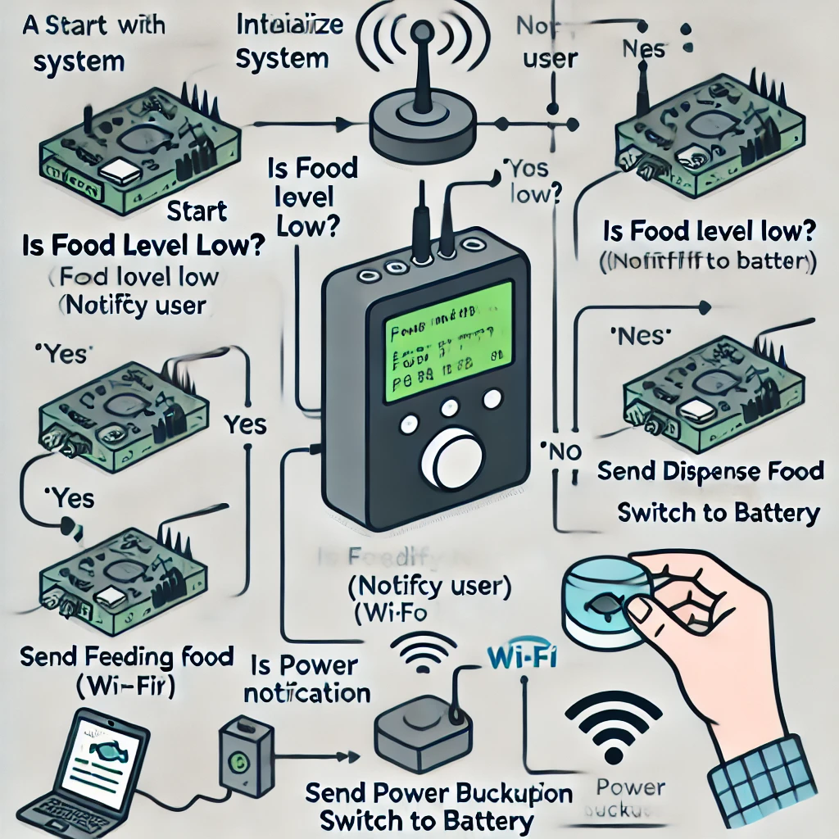
Flow Diagram:

Slide 7
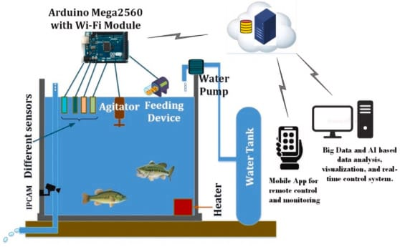
Design(optional):

Slide 8
Implementation: (Hardware or software)
Steps to Implement
Hardware Setup:
Servo Motor Installation: Attach the servo motor to the fish food container's opening. The motor will rotate to open and close the food dispenser based on the command.ESP8266/ESP32 Microcontroller: Set up the microcontroller to control the servo motor. The microcontroller will receive commands from the cloud platform.Wiring:Connect the servo motor to one of the GPIO pins of the ESP8266/ESP32.Set up the RTC module (optional) to maintain feeding times even without an active Wi-Fi connection.

Slide 9
IoT Platform Setup:
Blynk: Create a Blynk project, add a button widget, and link it to Virtual Pin V1. When you press the button, it will send a command to the ESP8266/ESP32, triggering the feedFish() function.Adafruit IO: Alternatively, you can use Adafruit IO to create a feed control dashboard. Set up an MQTT feed and use it to publish commands to the microcontroller.4. Cloud Integration:Use Blynk or Adafruit IO to set scheduled feeding times (e.g., feed the fish at 8 AM and 6 PM).Optionally, integrate with IFTTT to send notifications if the food container is empty (using the weight sensor data).5. Testing:Ensure the servo motor is calibrated properly to dispense the right amount of food.Set up a test schedule to check if the device is dispensing food at the set intervals.

Slide 10
Thank u slide
Thank You!

